Slide 1
Sensors
Week 4

Slide 2
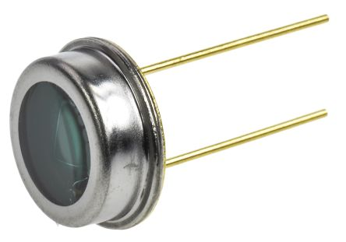
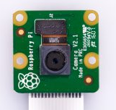
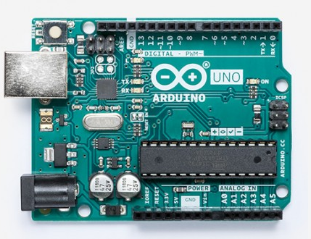
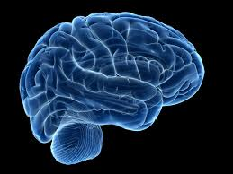
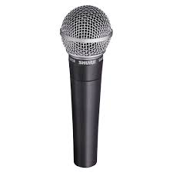
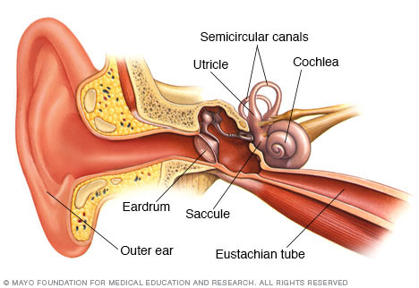
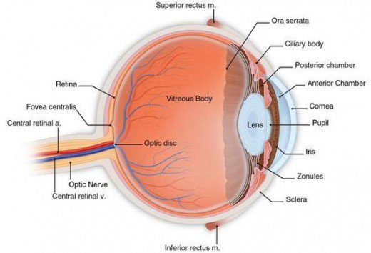
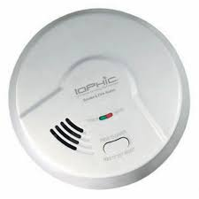

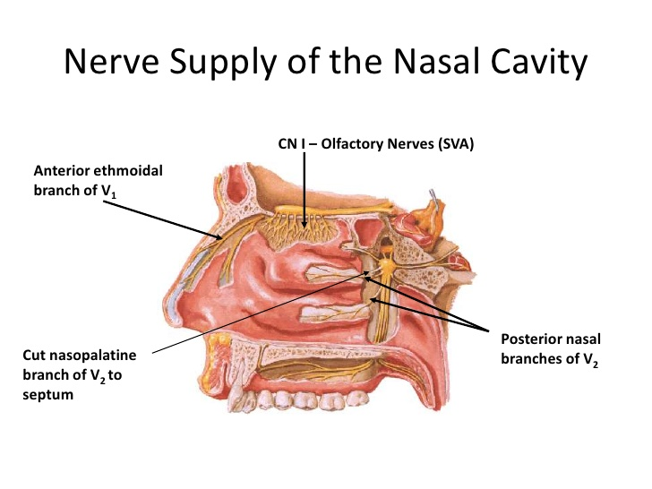
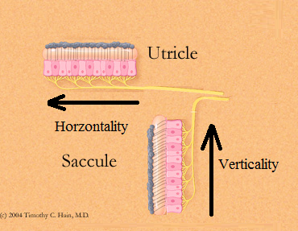

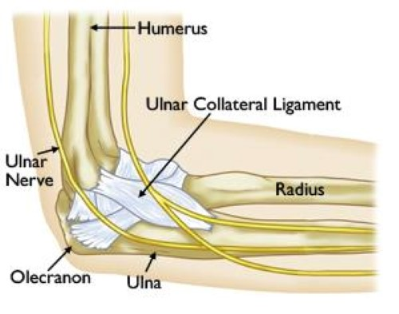

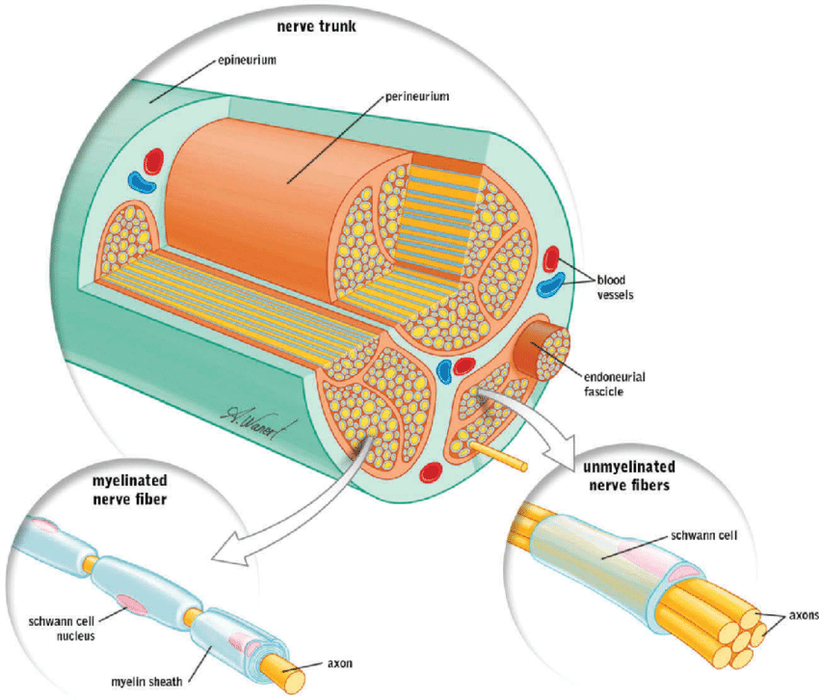
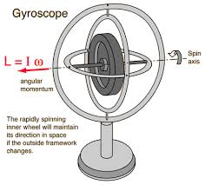
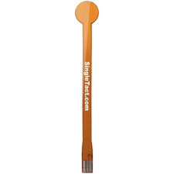
Biological sensors

Slide 3
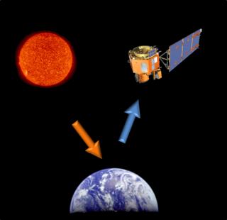
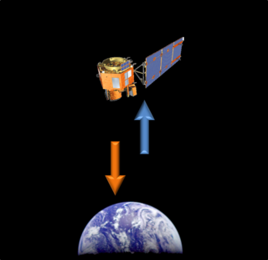
What are sensors?
Sensors are a device/component that detects for specific changes in the environment and converts it into an electrical signal for another device.
Two main types of sensors:
Passive Sensors
An instrument that is designed to receive and measure natural emissions.
E.g. Thermistors, photo diodes, etc
Active Sensors
This sensors is designed to transmit a specific type of signal/emission, then acquiring information based on the returned of the signal/emission.
E.g. Radars, Lidars, IR sensors, etc

Slide 4
Active Sensor Techniques
There are few common technique used to acquire different types of information from a returned Signal.
Time of Flight
Based of the travel time for a signal to hit the target and return to sensor. By knowing the time of flight and the speed the signal travels through a medium, the distance of the target can be determined.
Phase Shift
Using the change in phase, a distance can be derived (D= ØC/(4πf)).
Doppler Shift
Based on the change in frequency of the returned signal. This functions off the principle a moving object will have a shift in frequency. Used to detect speed and direction. Commonly used on speed guns.

Slide 5
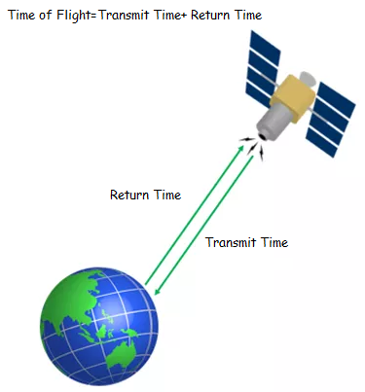
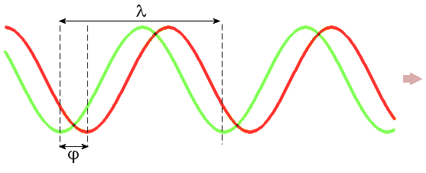
Some pictures
Time of Flight
Phase Shift
Doppler Shift
https://www.youtube.com/watch?v=a3RfULw7aAY

Slide 6
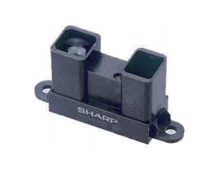
IR Sensors

Slide 7
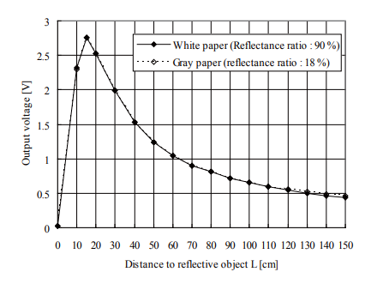

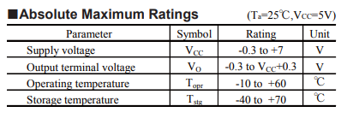
Our Sensor- IR sensor
Our sensor is the distance measuring sensor unit GP2Y0A02YK0F.
It is an active IR sensor.
Measuring distance: 20 to 150 cm
Converts Distance to an analog voltage output

Slide 8
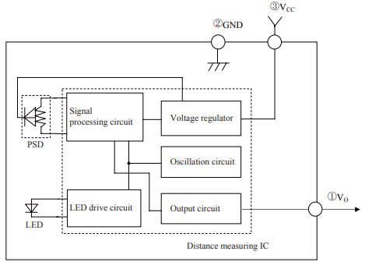

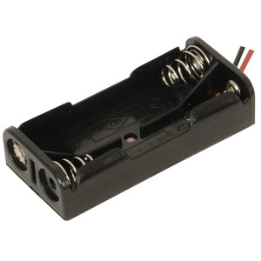
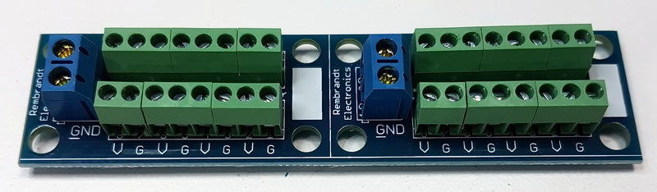
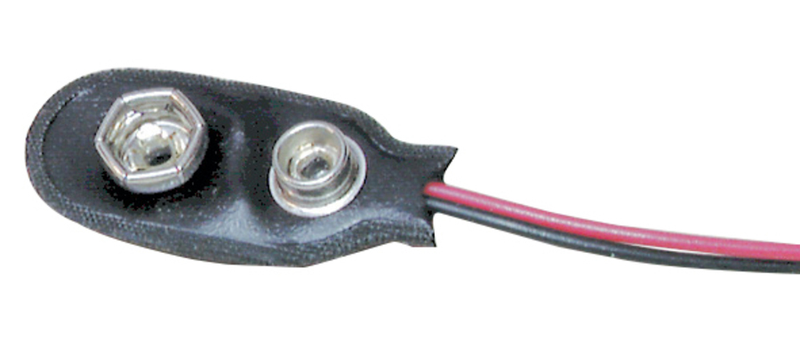
GP2Y0A02YK0F Block Diagram
5v pin
Ground Pin
Positron Sensitive Device
Analog Pin
Why is my LCD screen dim, or blinking when everything is plugged in?
Max current draw of the 5v pin is 400ma

Slide 9
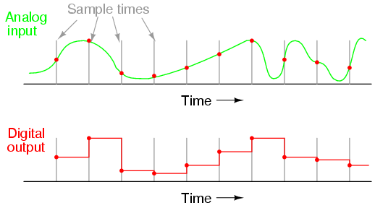
ADC module
The ATMega328P contain an Analog to Digital Converter module.
This module will take an analog signal (Continuous) and convert it into a digital signal (Discontinuous and Discrete) in the form of a 10-bit dataset.
This process is done through sampling, which is depending on the sampling rate and sampling resolution.
Do not use the Arduino library
analogread() function

Slide 10
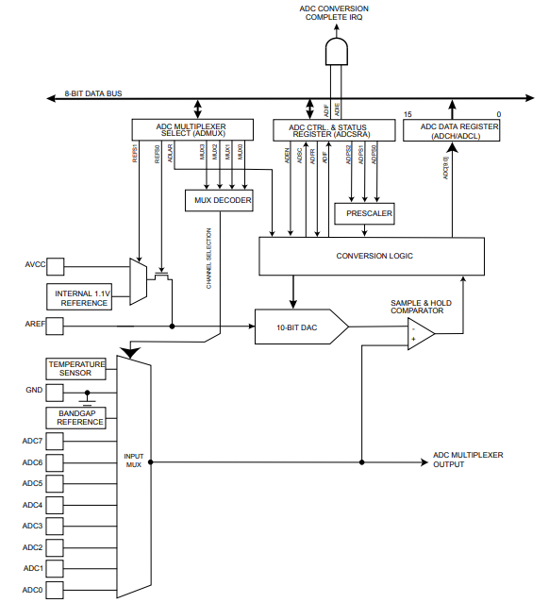
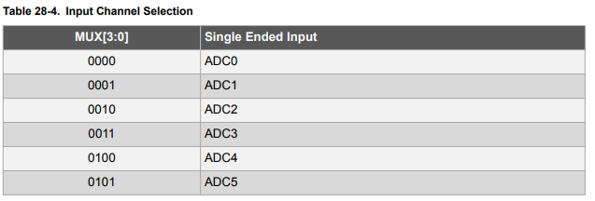
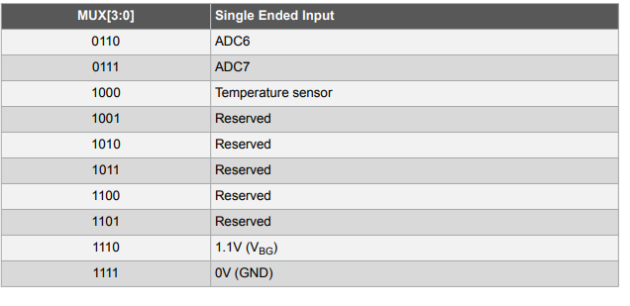
ADC ATMega328P Block Diagram

Slide 11
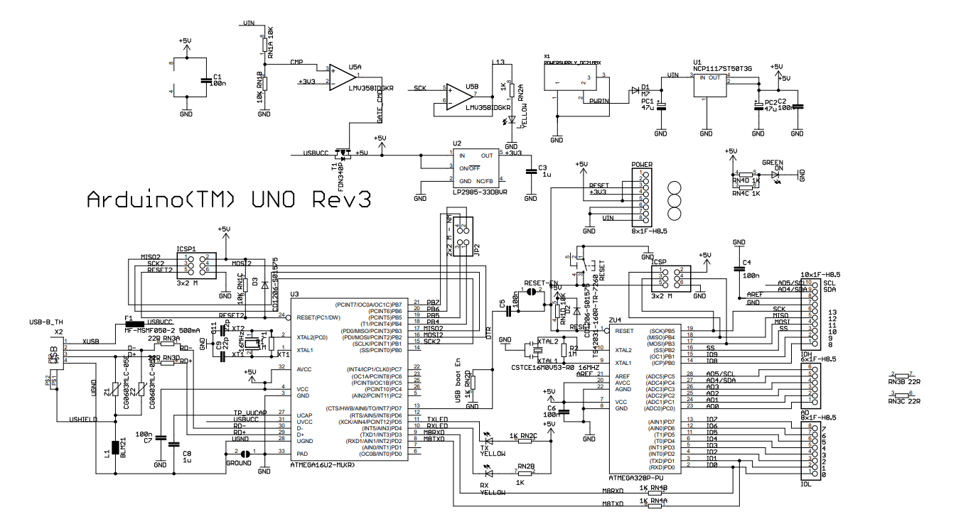
ADC Pin allocations

Slide 12
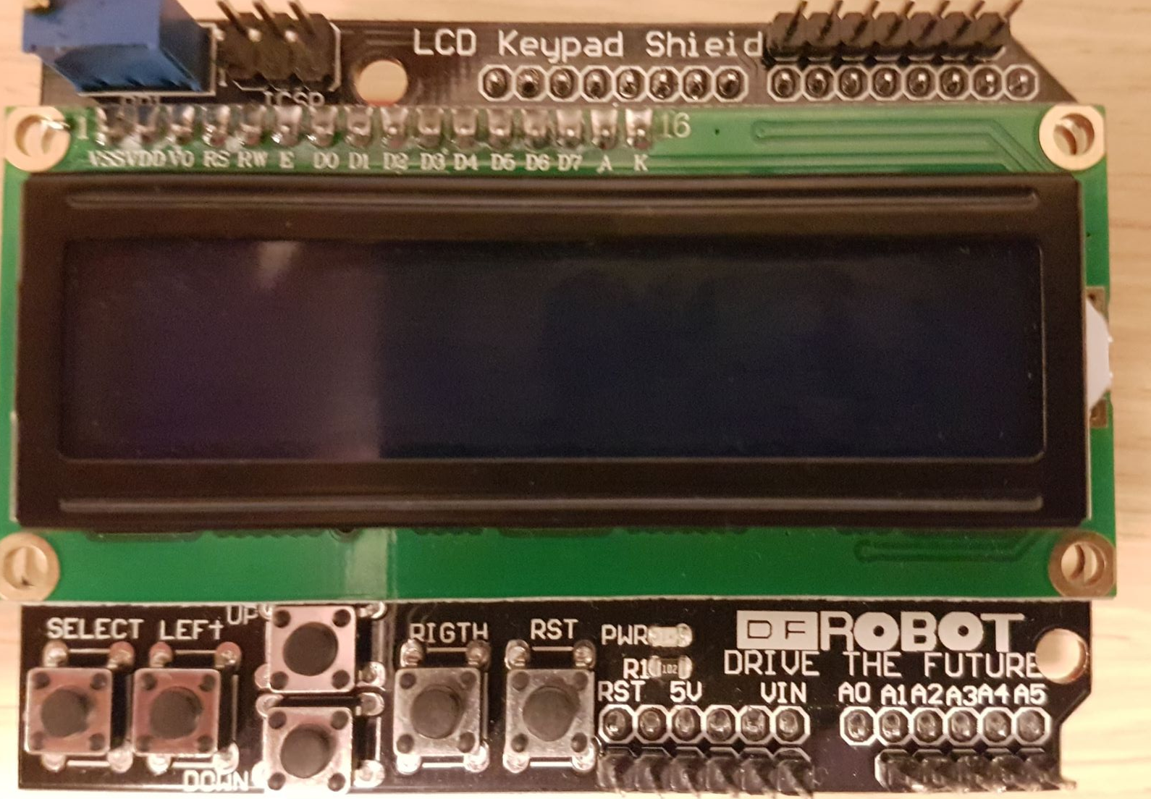
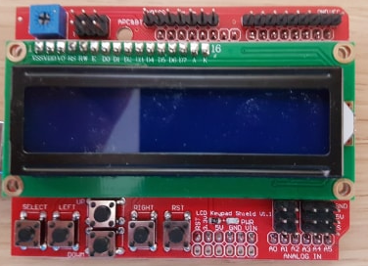
ADC Physical Pin Allocation
D13 D12 D11 D3 D2 D1 D0
APC&BT
D13 D12 D11 D3 D2 D1 D0 GND VCC
GND
5V
A1 A2 A3 A4 A5
Reset 3.3V 5V GND GND VIN
A1 A2 A3 A4 A5

Slide 13
10-bit address
The ADC outputs the digital data in a 10-bit(0-1023) form, as we know registers are 8-bit long, so how does this happen?
By separating the 10-bit data into two 8-bit addresses with 6 unoccupied bits.
The output can be left or right justified
1010101100
Left Justified(ADLAR=1)
9 bits 0
Right Justified (ADLAR=0)
10101011 00000000
00000010 10101100
ADCH ADCL
ADCH ADCL

Slide 14

10-bit address
Now how can we store/check the result?
Traditionally on the PIC18 you would have to do this:
Create a 16 bit variable with 0x0000 stored.
Use OR (|) operators and bit shifts (<<)(>>) to store the value.
e.g.
Fortunately for you, the ATMega328 allows you to call both registers as ADC
e.g.
ADCH=0b00000010 and ADCL= 0b10101100
ADC=1010101100
ADCH ADCL
ADC Store
ADC Store|ADCH
ADC Store<<8
ADC Store|ADCL
00000010 10101100
0000000000000000
0000000000000010
0000001000000000
0000001010101100

Slide 15
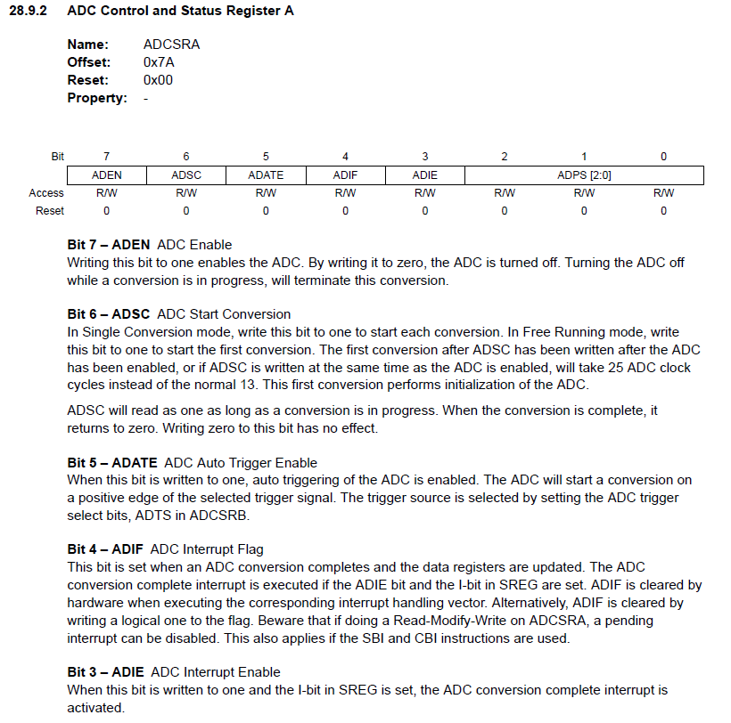

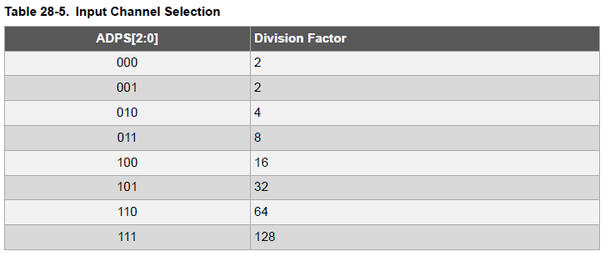
ADC Conversion Process
Configure Control/Status registers A and B to desired settings.
There are interrupt settings and ADC can be sync to a Timer trigger.
Key thing is to set ADC Enable bit to enable the conversion.
Set ADC Multiplexer Select register to the desired port.
Don’t forget to select desired reference voltage.
When ready to start conversion, set the ADC Start Conversion bit to one.
You need to wait for the conversion to complete, this is shown through ADC Interrupt Flag being set to a logic one. If you do not wait for conversion to complete, you will read the incorrect value.
You can clear the Interrupt Flag by writing a logical one to the bit. Don’t forget to clear the bit!.
Read/Store the converted value through the ADC variable.

Slide 16
Interpreting Data-IR sensor
The ADC value reading is not the distance or the voltage reading.
It is a scalar value between 0-1023 (10-bit range).
For the IR sensor you will need to find a way to convert this scalar value into distance.
One way is to use a tape measure and take the ADC readings at set distances to create a graph of the ADC-distance conversions.
Another way is to convert the 0-1023 scalar value into the voltage value (0-5v), then using the datasheet convert the voltage into distance.

Slide 17
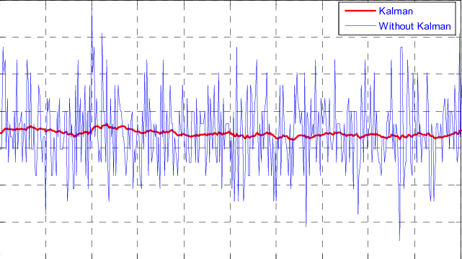
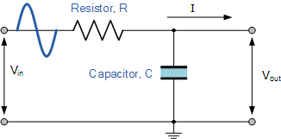
Noise
RC Filter Circuit
Implement Software filters (Butterworth, Kalman, Band pass, Chebyshev, etc)
Average Sample i.e. Take multiple datapoints and find the average value
Manual Filtering e.g. Ignore spiking values, or thresholding values.
Low Pass RC

Slide 18
TinkerCAD
https://www.tinkercad.com/things/lcyZxG2g8pC-uts-mx2-lesson-plan-week-4-adc-

Slide 19
Exercise 1 LCD
Use the attached exercise code on UTS Online for this week.
The code is an example code found online for the LCD.
Modify the read_LCD_buttons() function to use AVR ADCconversion instead of analogread()
Read the datasheet’s ADC chapter and follow the comments to complete this exercise.

Slide 20
Exercise 2 IR
Apply the same ADC conversion method to the IR sensor pin.
Output the raw ADC reading for the IR sensor to the LCD.
You can replace the check button function with a check IR function and then print the raw value.
For the assignment you will need to convert this to distance.
Also, consider on how to make the readings stable.

Slide 21
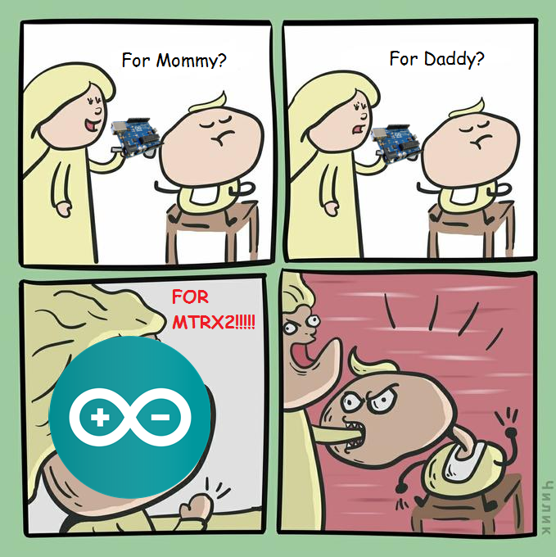
Good luck next week!

Slide 22
References
https://www.nasa.gov/directorates/heo/scan/communications/outreach/funfacts/txt_passive_active.html
http://lunainc.com/wp-content/uploads/2016/07/Photodiodes-300x257.jpg
https://storage.googleapis.com/stateless-www-faranux-com/2017/09/Thermistor.jpg
https://cdn.shopify.com/s/files/1/1476/3514/products/Amazon_D_-_Bigger_Resize_530x_7ace73a6-c2ee-44f0-b004-820948269207_300x300.jpg?v=1487676309
https://sailandboat.com/author/panbo/
https://upload.wikimedia.org/wikipedia/commons/d/d5/Phase_shift.gif
GP2Y0A02YK0F Datasheet
ATMega328P Datasheet
https://i.ebayimg.com/images/g/rRkAAOSwqklZiFwp/s-l300.jpg
https://www.littlebirdelectronics.com.au/assets/full/TB-PH9230.jpg
https://www.jaycar.com.au/medias/sys_master/images/9116814344222/2-x-aaa-cell-battery-holderImageMain-300.jpg
https://www.rembrandtelectronics.com/wp-content/uploads/2016/12/RE-0453-Power-Rail-for-Domotica-1-800-T.jpg

Slide 23
References
https://www.globalspec.com/ImageRepository/LearnMore/20142/042536fba47d9841442fdb60540601045cf5d.png

